Slide 1
Position-Adaptive Stimulation and Improved Pain Relief: Results of the RestoreSensor Study
Lynn Webster, MD
Lifetree Clinical Research and Pain Clinic, Salt Lake City, UT
David Schultz, MD
MAPS Applied Research Center, Edina, MN
Mark Sun, PhD
Medtronic, Inc., Minneapolis, MN
Ye Tan, MS
Medtronic, Inc., Minneapolis, MN

Slide 2
Presenter Disclosure Information
Employee at Medtronic, Inc.
  RestoreSensor clinical study manager

Slide 3
Background
For many patients, the intensity of spinal cord stimulation changes with body position¹⁻³
Position-related changes in stimulation intensity may limit therapy efficacy and patient satisfaction⁴
A position-adaptive stimulation feature was developed to address these challenges
Olin JC, Kidd DH, North RB. Postural changes in spinal cord perceptual thresholds. Neuromodulation. 1998;1:171–175.
Cameron T, Aló KM. Effects of posture on stimulation parameters in spinal cord stimulation. Neuromodulation. 1998;1:177–183.
3. Abejón D, Feler C. Is impedance a parameter to be taken into account in spinal cord stimulation? Pain Physician. 2007;10:533–540.
4. Kuechmann C, Valine T, Wolfe D. Could automatic position-adaptive stimulation be useful in spinal cord stimulation? 2009. Poster presented at: 6th Congress of the European Federation of ISAP® Chapters (EFIC); September 9–12, 2009; Lisbon, Portugal.

Slide 4
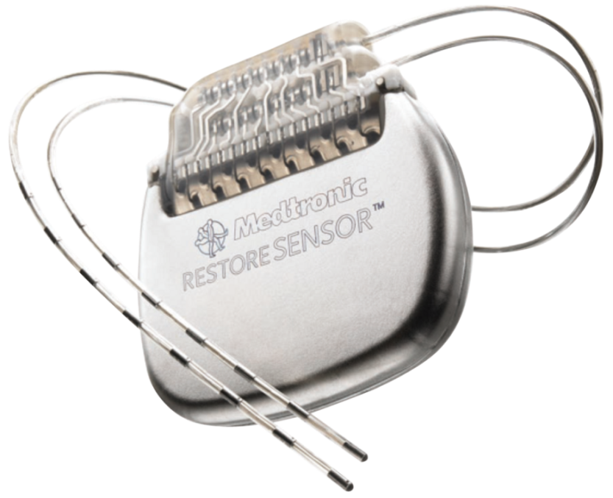
Background
RestoreSensor study demonstrated the clinical benefits of position-adaptive stimulation⁵
5. Schultz DM, Webster L, Kosek P, Dar U, Tan Y, Sun M. Sensor-driven position-adaptive spinal cord stimulation for chronic pain. Pain Physician. 2012;15:1-12.

Slide 5
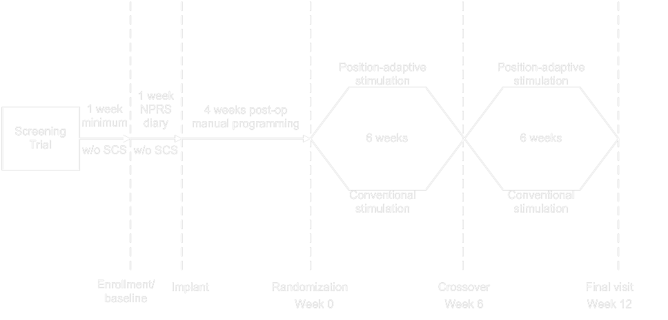
Study Design

Slide 6
Patients
Patients enrolled: N = 79 at 10 US study centers
Age: 52.6 (27 - 85) years
Female: 60%, N = 47
Male: 40%, N = 32
Baseline average NPRS scores: 6.1 (2.7 - 10)
Notes:
6

Slide 7
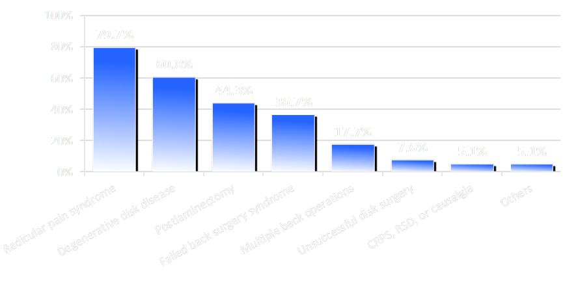
Pain Etiologies

Slide 8
Dual Primary Efficacy Objective
Improved pain relief with no loss of convenience
and/or
Improved convenience with no loss of pain relief

Slide 9

Primary Efficacy Objective Assessment:
Two Separate 5-Point Likert Scales
Assessment of Pain Relief:
Assessment of Convenience:
1
2
3
4
5
Much worse Somewhat worse No difference Somewhat better Much better
Much less Somewhat less No difference Somewhat more Much more

Slide 10

Composite Primary Efficacy Results: Improved Pain Relief and/or Convenience
86.5%
p<0.001
Predefined
acceptance threshold
Notes:
10

Slide 11

Improved Pain Relief

Slide 12

Improved Convenience

Slide 13
Conclusions
Position-adaptive stimulation improved pain relief and/or convenience for most patients when compared with conventional stimulation
Reported improvements in pain relief and/or convenience may lead to greater overall patient satisfaction with spinal cord stimulation therapy

