Slide 1
Lifetime achievement award
Dr. Joshua Prager

Slide 2
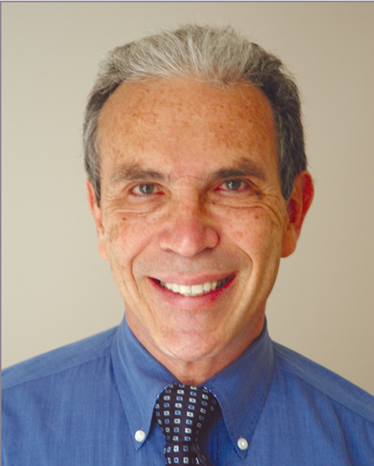
Dr. Joshua Prager

Slide 3
The begining
Born in Queens NY and educated in the NY Public School System
Parents: New York City police officer and later New York City Public School Teacher (Mom) and United Cerebral Palsy shelter workshop supervisor (Father)
Worked and put himself through medical school

Slide 4
Academic Achievements
Undergraduate - Stony Brook University (Chemistry)
Premedical education - Harvard University: policy planning and administration
Medical School - Stanford University, School of Medicine
Stanford Masters Program in management and health services research at the Graduate School of Business
Internship: UCLA Center for the health sciences internal medicine
Residency UCLA Center for the health sciences internal medicine
Residency Stanford University Hospital Anesthesiology
Residency and Clinical fellow Harvard Medical School at the Massachusetts General Hospital – Dept. of Anesthesiology

Slide 5
Professional achievements
Board Certifications
American Board of Internal Medicine
American Board of Anesthesiology
American Board of Anesthesiology: Subspecialty Pain Medicine
American Board of Pain Medicine
Author of many articles, book chapters, and consensus guidelines

Slide 6
An Expert
California Board Of Medical Quality Assurance 19 years
Atty. Gen. State Of California 18 years
District Attorney County of Los Angeles
Medical Evidence Evaluation Advisory Committee (MEEAC), developing guidelines for medical treatment of injured worker 6 years
Expert witness

Slide 7
Public service
High school tutoring math in Harlem, organizing weekend youth conferences on educational topics for the Unitarian Universalist high school youth organization
During college - Wider Horizons (a big brother like program for migrant worker children), nonprofit rock concert promoter for major rock concerts.
After college - fundraising and development work to start a community owned and operated healthcare facility in Bedford Stuyvesant New York for indigent aged.
After medical school: - Haight-Ashbury free clinic volunteer internist, Inter-Plast volunteer anesthesiologist for international work performing plastic surgery reconstruction on Third World children with congenital anomalies.

Slide 8
NANS
Founding fathers of NANS – 1994
Board of Directors, Secretary, Vice-President, President-elect, President, Immediate Past President, Senior Advisor to the board.
President – 2005/6
Annual meeting Co- Chair for six years with an attendance increase from 164 to over 1000 with a concomitant increase in NANS members
Instrumental in turning around the financial status of NANS
Contributing editor Journal of Neuromodulation
Senior Advisor to the Board

Slide 9
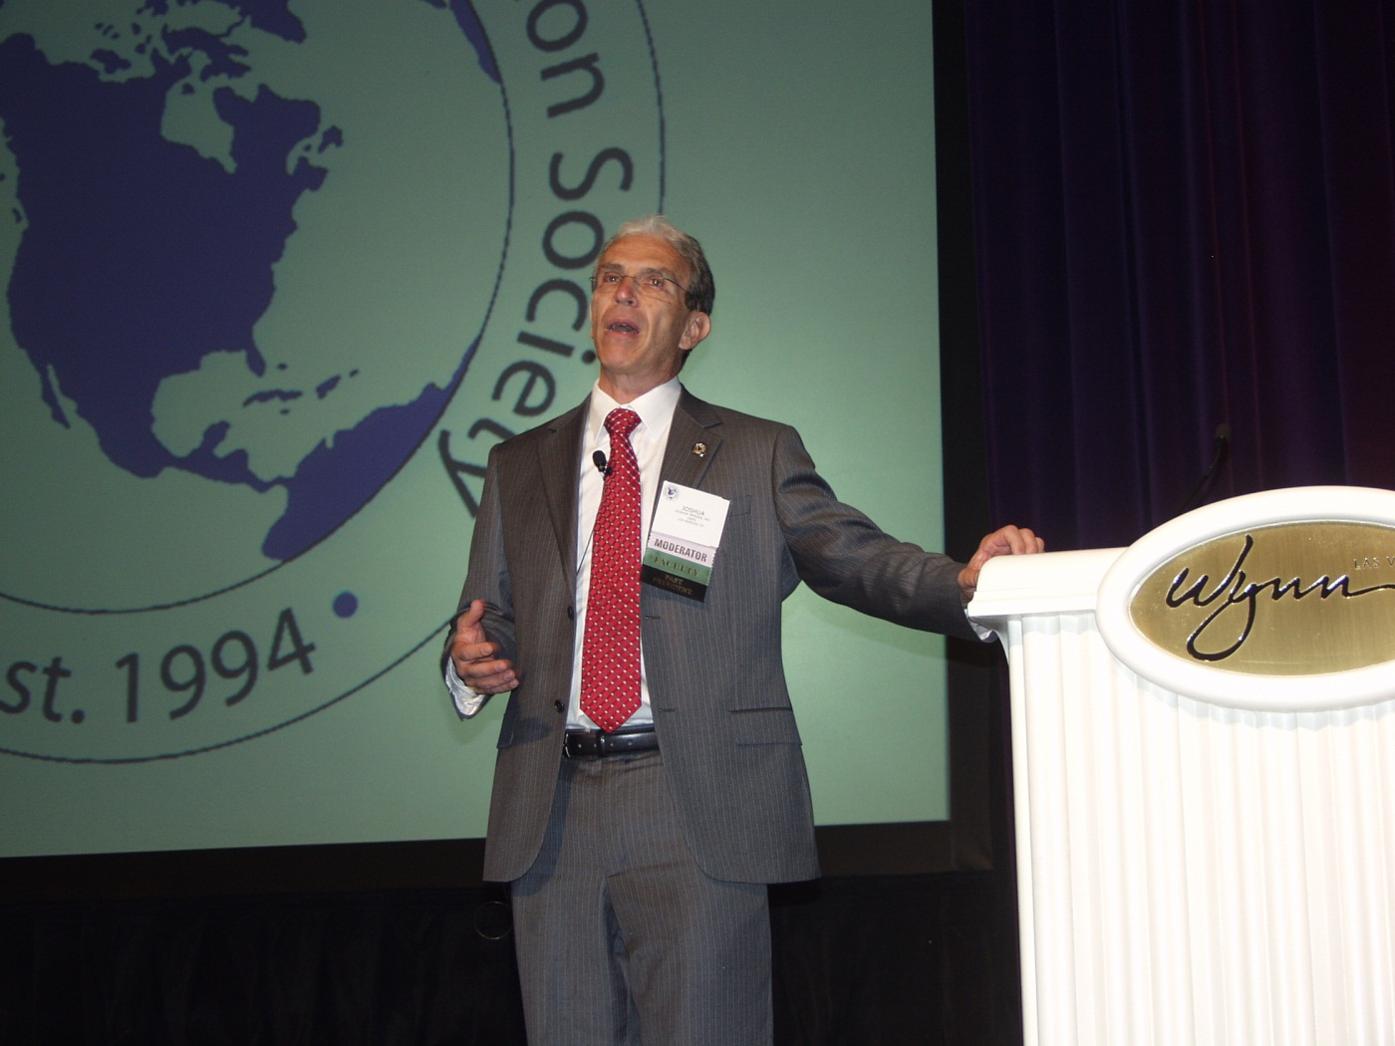

Slide 10
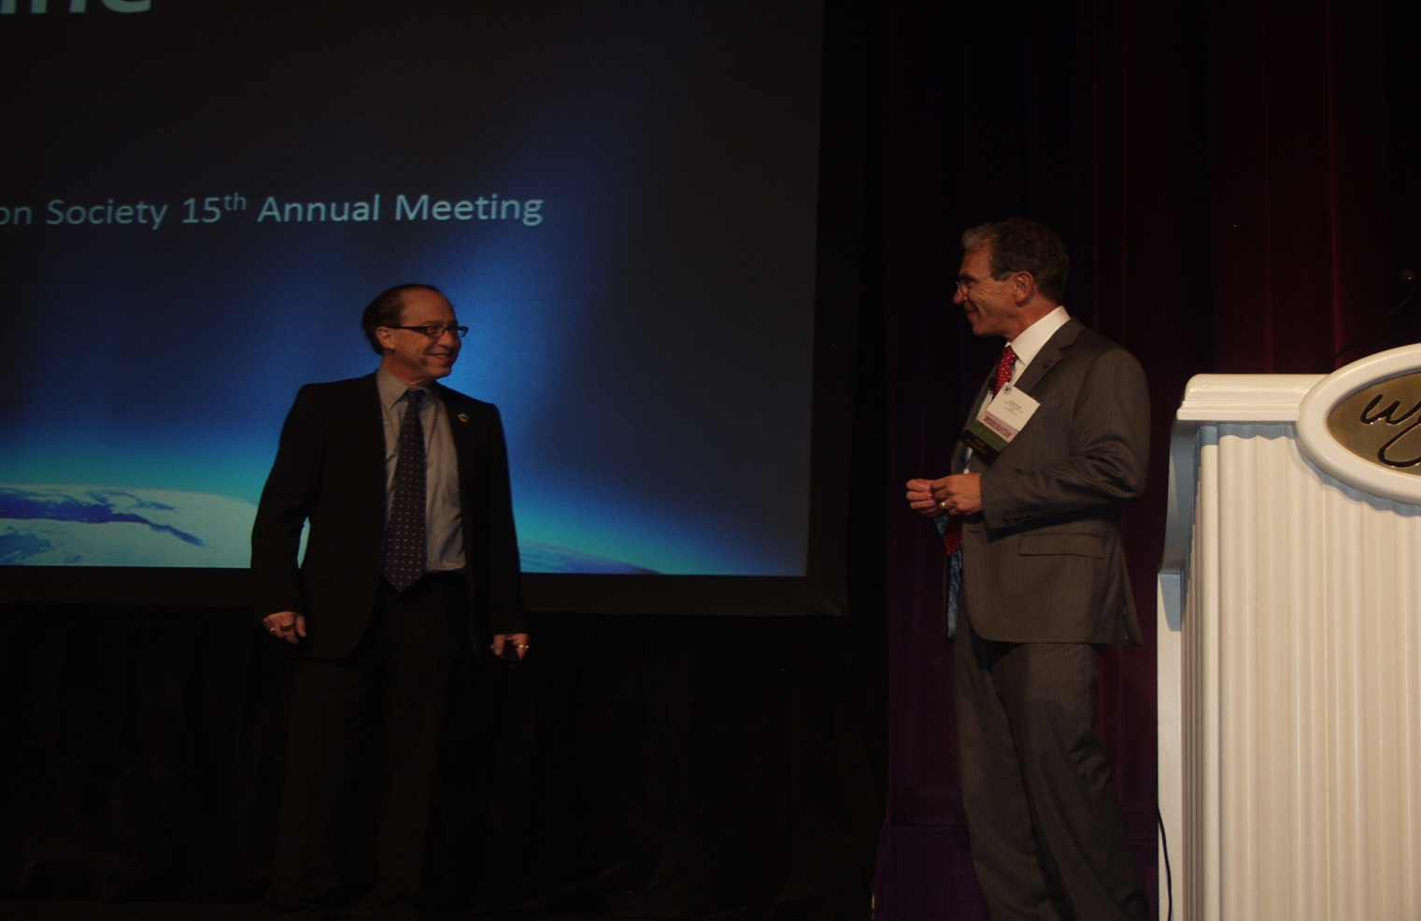
Dr. Prager introducing Ray Kurzweil

Slide 11
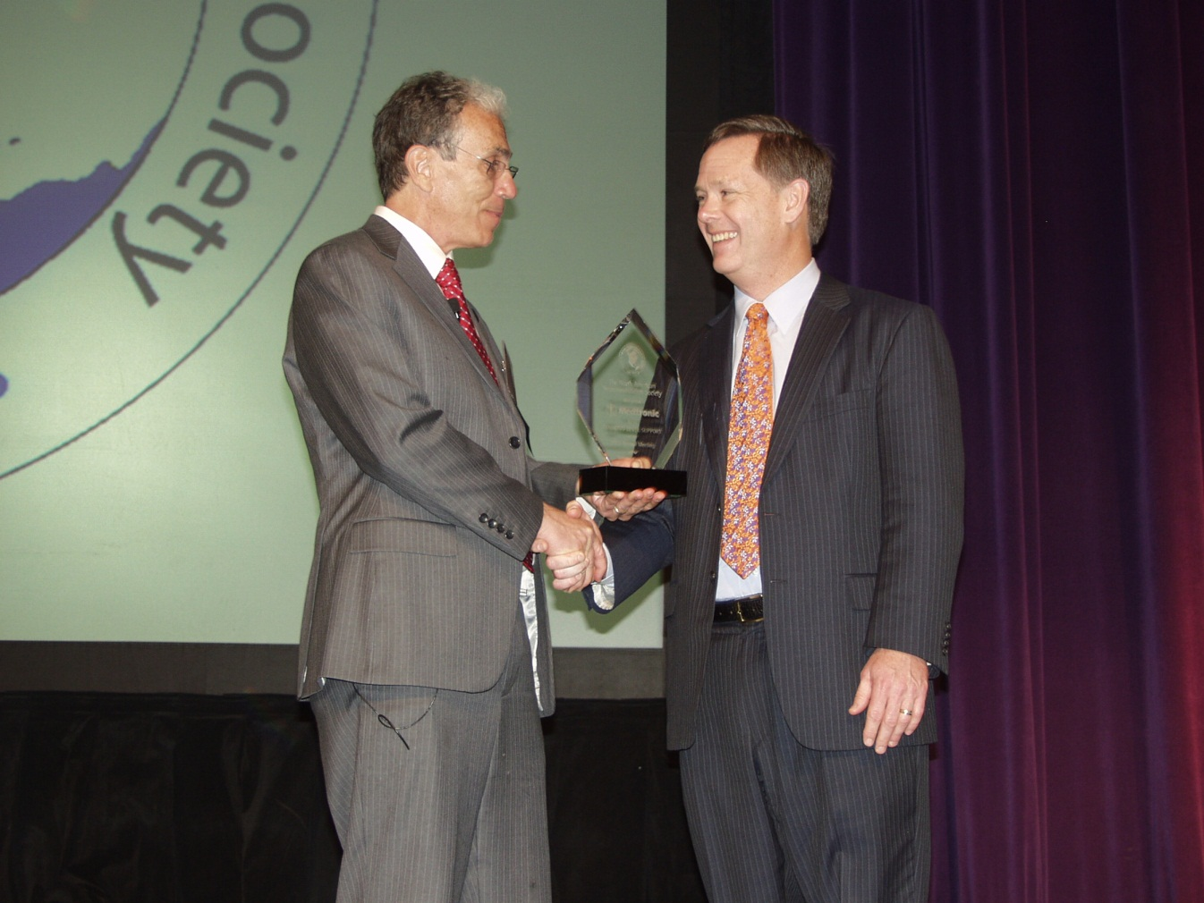
Dr. Prager and Tom Tefft

Slide 12
Ntac Neuromodulation Therapy access coalition
Three industry partners working together
Major societies working together - AAPM, ASIPP, ISIS, AND NANS
Chair for 6 years 2005-2011
ACOEM
Start of collaboration
Involved in many state initiatives
SCS and SODS guidelines
Leader of NTAC project on SCS guidelines

Slide 13
Cpps Council of Pain physician societies
AAPM, ASA, ASRA, ASIPP, ISIS, and NANS
3 meetings to date and more planned
Most recent meeting DC in October during the ASA
Proposed NCD on SCS, PNS, and DBS
The importance of these societies finding common ground for the survival of the field of IPM has been the guiding principle of Dr. Prager

Slide 14
Leader in the field of neuromodulation and pain management
Expert on Complex Regional Pain Syndrome
Participated and authored numerous studies
Taught more than 100 cadaver workshops
Lectured extensively in the United States, Europe, Australia, and Asia
CRPS – The Center For The Relief of Pain Syndromes
Pain organizations: International Association for the Study of Pain (IASP) , chair of pain and sympathetic nervous system (CRPS) group for four years
Multiple Committees For The American Academy of Pain Medicine and the American Pain Society including managed care committee, program committee, external affairs committee.
Special-interest in mechanism of spinal cord stimulation, patient selection for neuromodulatory techniques, spinal cord stimulation for complex regional pain syndrome, and safety of intrathecal therapy.

Slide 15
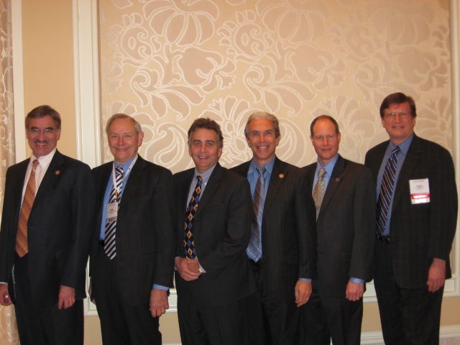
Dr. Robert Foreman, Dr. Michael Stanton-Hicks, Dr. Peter Staats, Dr. Prager, Dr. Jaymie Henderson, and Dr. Richard North (L to R)

Slide 16
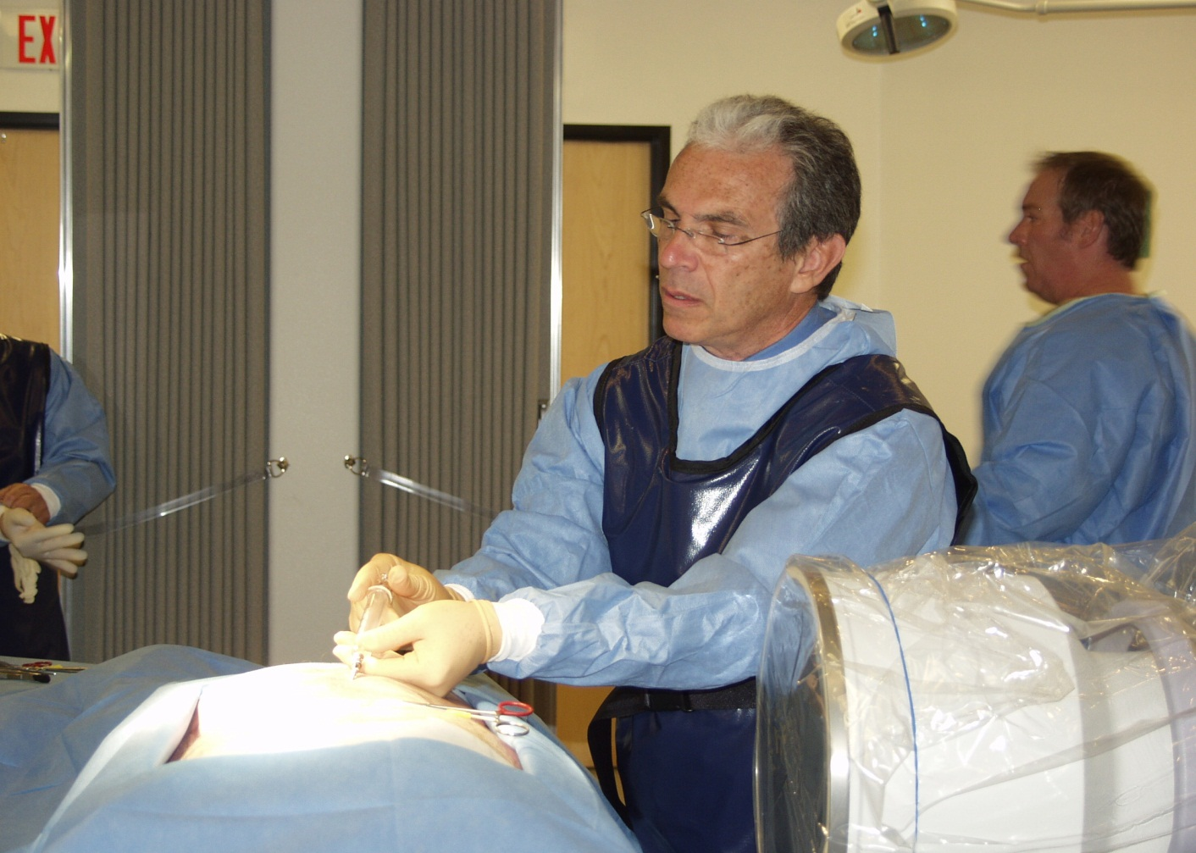
Dr. Prager teaching

Slide 17
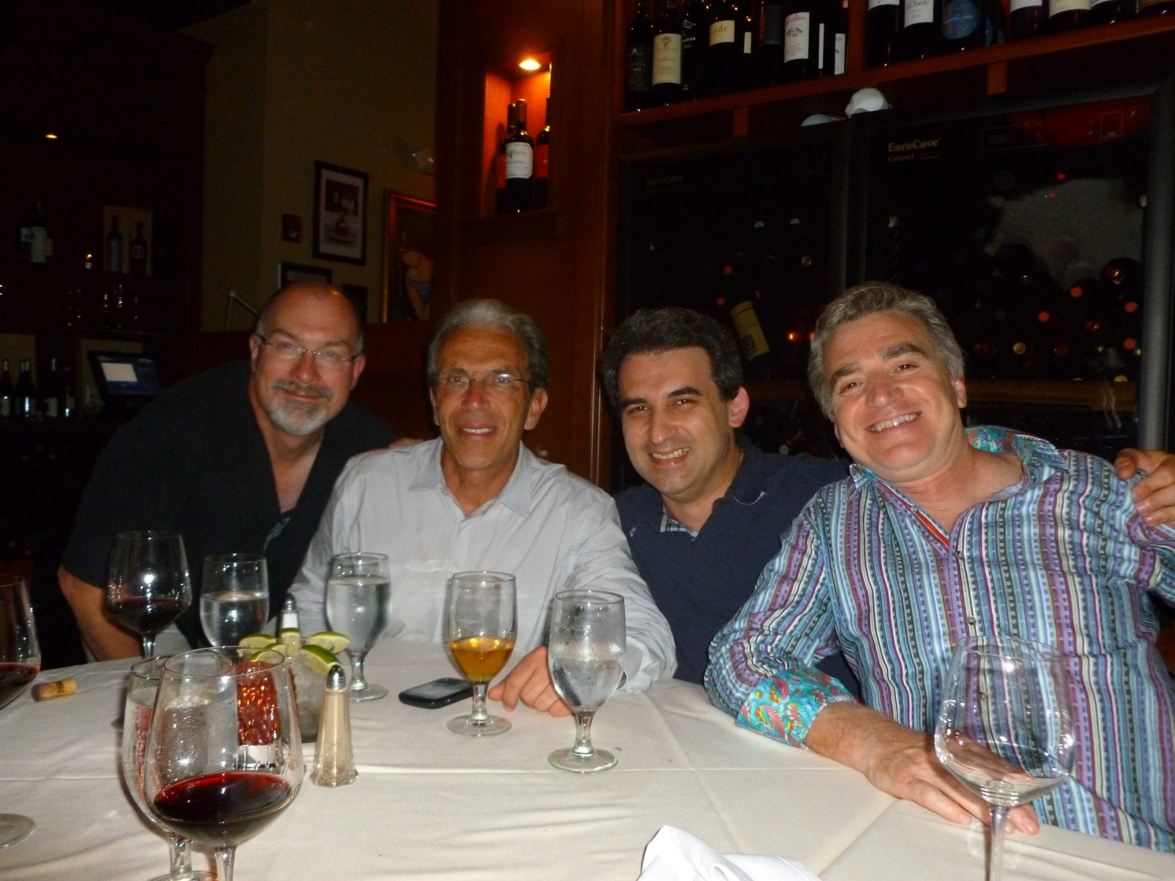
Dr. Mark Huntoon, Joshua Prager, Konstantin Slavin and David Caraway

Slide 18
blues harmonica Player
Dr. Lester "Les" Payne
Performances in Chicago and Memphis

Slide 19
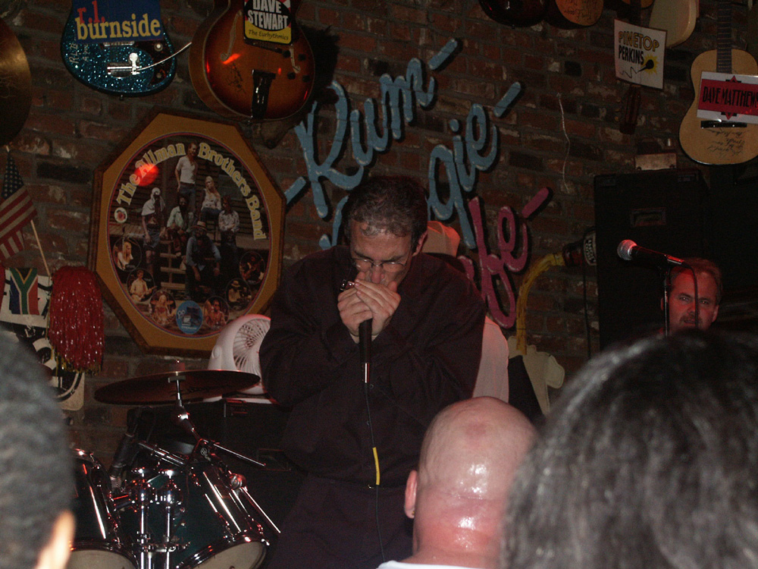

Slide 20
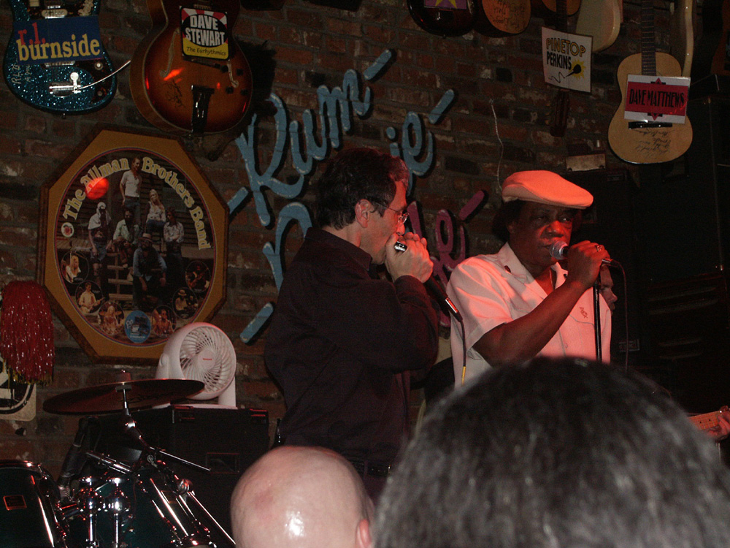

Slide 21
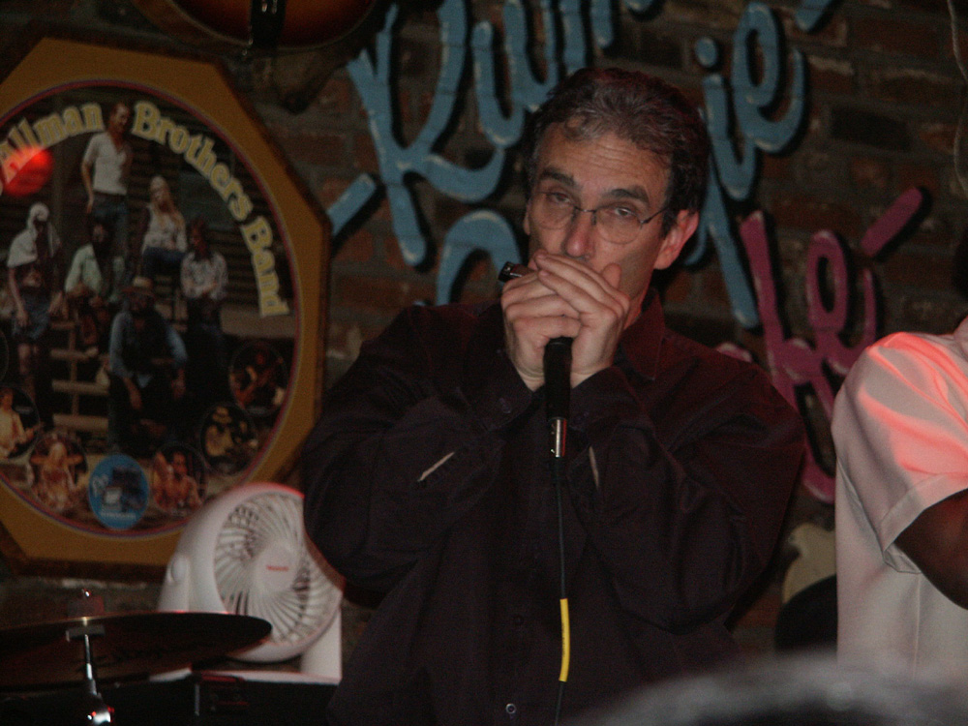

Slide 23
And a family Man Melanie Alex, Jacob, and Matthew 10th Anniversary Today

Slide 24
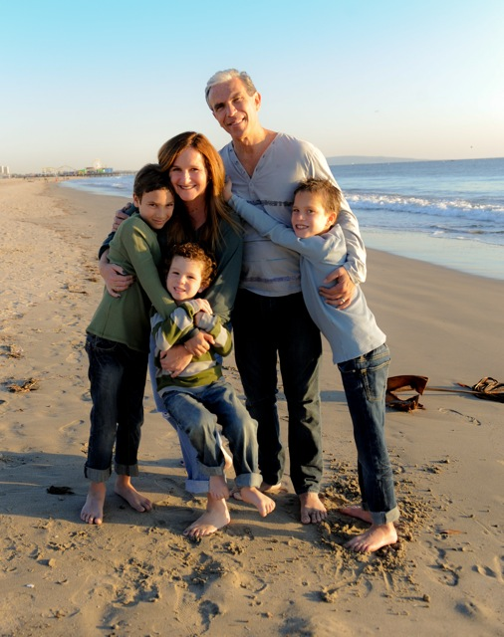

Slide 25
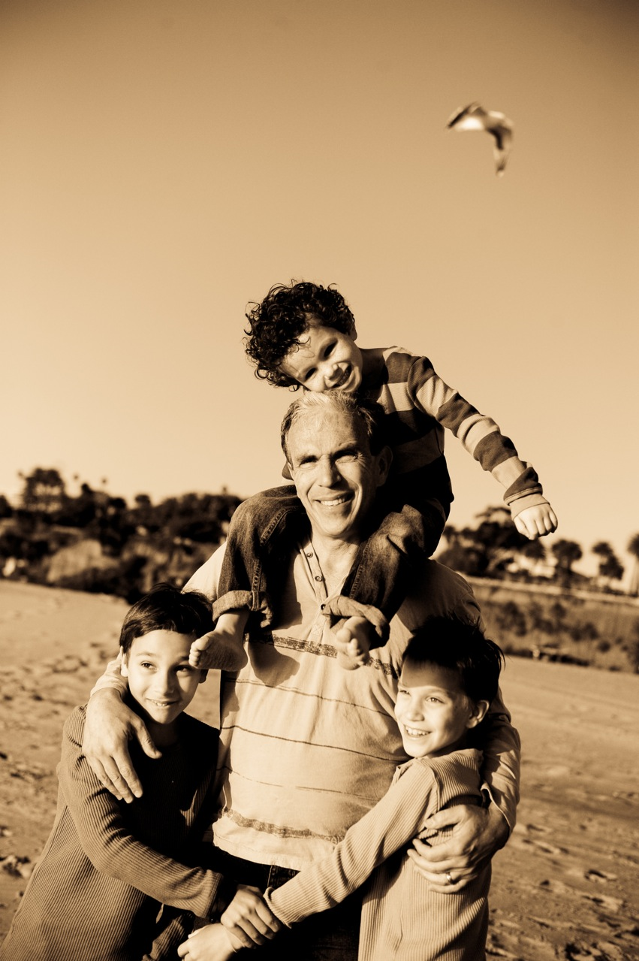

Slide 26
A medical colleague and friend
Wise counsel
Professional in his work with others
Tough negotiator
Politely forceful, but gentle
Thoughtful and measured
And when that doesn’t work … coercion

Slide 27
